Slide 1
Cloud Technology Fundaments 21UCA501

Slide 2
The Google APIs
Most Google services are exposed by an API, which is why you find a version of Google’s search engine, Google Maps, YouTube videos, Google Earth, AdWords, AdSense, and even elements of Google Apps exposed in many other Web sites.

Slide 3
The Google APIs
Google’s APIs can be categorized as belonging to the following categories:
l Ads and AdSense: These APIs allow Google’s advertising services to be integrated into Web applications. The most commonly used services in this category are AdWords, AdSense, and Google Analytics.
l AJAX: The Google AJAX APIs provide a means to add content such as RSS feeds, maps, search boxes, and other information sources by including a snippet of JavaScript into your code.
l Browser: Google has several APIs related to building browser-based applications, including four for the Chrome browser. This category includes the Google Cloud Print API, the Installable Web Apps API for creating installation packages, the Google Web Toolkit for building AJAX applications using Java, and V8, which is a high-performance JavaScript engine.

Slide 4
The Google APIs
l Data: The Data APIs are those that exchange data with a variety of Google services. The list of Google Data APIs includes Google Apps, Google Analytics, Blogger, Base, Book, Calendar, Code Search, Google Earth, Google Spreadsheets, Google Notebook, and Picasa
Web Albums.
l Geo: A number of APIs exist to give location-specific information hooking into maps and geo-specific databases. Some of the more popular APIs in this category include Google Earth, Directions, JavaScripts Maps, Maps API for Flash, and Static Maps.

Slide 5
The Google APIs
l Search: The search APIs leverage Google’s core competency and its central service. APIs such as Google AJAX Search, Book Search, Code Search, Custom Search, and Webmaster Tools Data APIs allow developers to include Google searches in their applications and web sites.
Social: Many Google APIs are used for information exchange and communication tools. They support applications such as Gmail, Calendar, and others, and they provide a set of foundation services. The popular social APIs are Blogger Data, Calendar, Contacts, OpenSocial, Picasa, and YouTube.

Slide 6
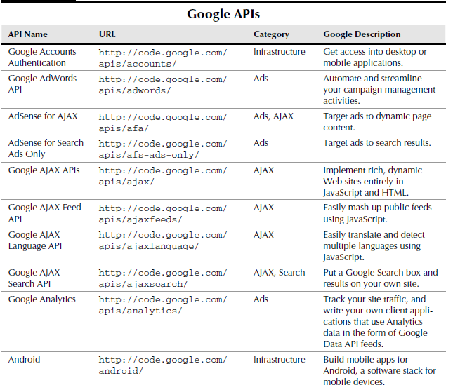
The Google APIs

Slide 7
THANK YOU

